Slide 1
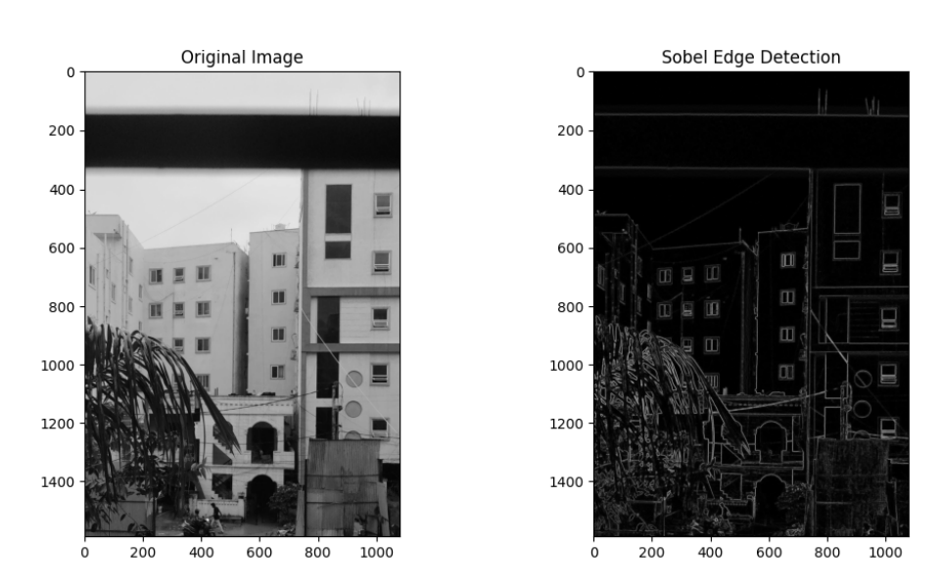
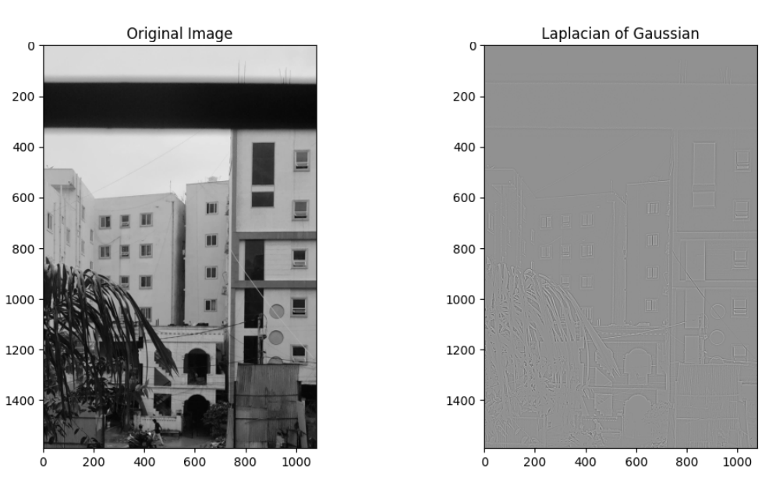
CV ASSIGNMENT 1 Faculty : Dr Tilottama Goswami
Section : A
Group Number : 2
Roll Numbers : 1602-20-737-024, 039
Names : Md Asaduddin, Narsini Shravani
Image Processing Task : Edge Detection
Algorithms Used : Sobel, Laplacian of Gaussian
Github Link: https://github.com/ShravaniNarsini/CV
Input and Output Images :

